Slide 1
SILLM – Final Project
Comparing different prompting techniques on different topics
Claire Jordan, Sharon Bures, Elena Solar

Slide 2
Math problems
A plague infects ten people. Every day, each infected person infects six others. How many people are infected after three days?
Answer: 3440
Plague infection (1):
Last name letters (3):
Samantha's last name has three fewer letters than Bobbie's last name. If Bobbie took two letters off her last name, she would have a last name twice the length of Jamie's. Jamie’s full name is Jamie Grey. How many letters are in Samantha's last name?
Answer: 7
Raspberry bush (5):
A raspberry bush has 6 clusters of 20 fruit each and 67 individual fruit scattered across the bush. How many raspberries are there total?'
Answer: 187
Phone installments: (7)
Shiela bought five cell phones for $150 each for a 3-month installment. A 2% interest will be charged for each unit. How much will Shiela pay each month for 3 months? Answer: $255

Slide 3
Prompt Variations
Blurry
Math is such a vast and interesting field, like I could spend so much time just looking through math problems, learning all about algebra, calculus, trigonometry, derivatives, statistics, probability and so much more. I imagine all sorts of problems and how to solve them. Anyway I'm stuck on this question and want you to help me with it.
Emotional
Please help me, I need to solve this math problem but I'm so stuck on it. I need to show the correct answer today or else I get fired and I can’t handle that. If I don't I may lose my job, and I really really need to keep it in order to earn money and make sure my family is taken care of
Chain of thought
Example math question from the same database
Expert persona
You are an expert mathematician with several decades of experience in your field. You have written many important texts about the foremost mathematical topics and are one of the leading authors in the field. You are also the head mathematics professor at a prestigious university.
Non-Expert persona
You are a below average 3rd grade student. You have never been particularly good at math, instead being better at the arts and sports. You do not pay attention in math class and have no idea what's happening there.

Slide 4
Models
Mistral
10 problems
3 runs
GPT 3.5
10 problems
3 runs
Overall
Default prompt: no switch of position
Chain of thought: instructions placed at the beginning and the end
Others: Instructions placed at the beginning, middle, and the end
450 results total

Slide 5
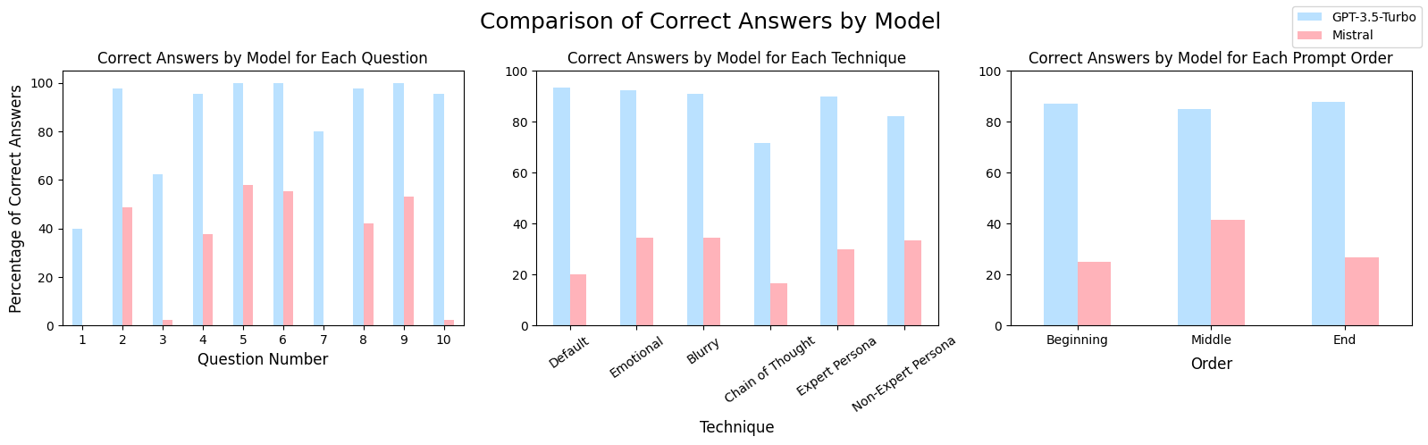

Accuracy

Slide 6
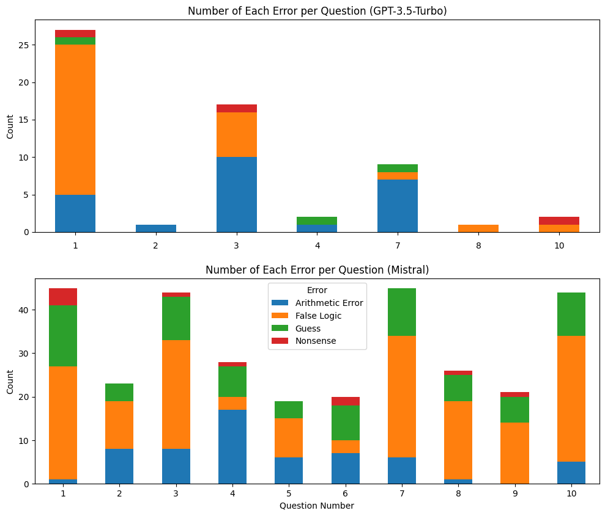
Types of Errors per Question

Slide 7
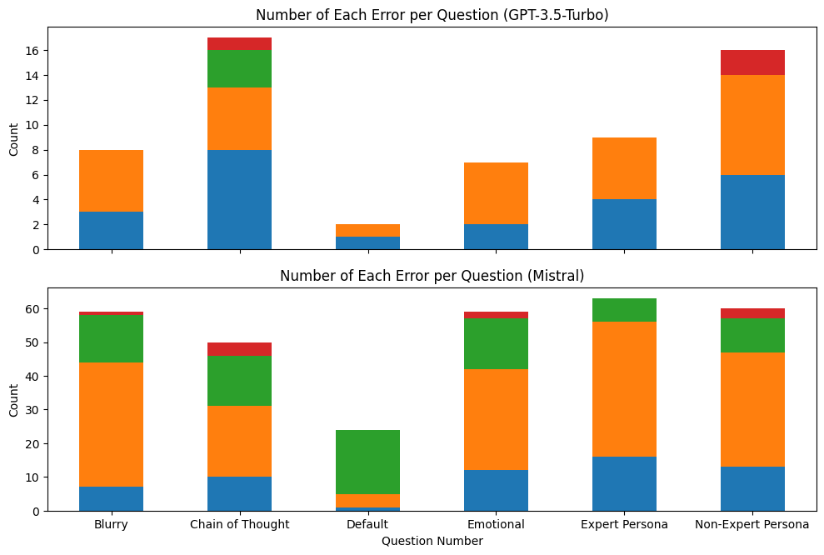
Types of Error per Technique

Slide 8
Summary of Math Part
Default enough for GPT-3.5, emotion and expertise helps Mistral
No effect of position
Chain of thought exploration needed
Choosing more difficult math problems for GPT-3.5 and GPT4

Slide 9
Thanks for your attention

